Slide 1
DIGITAL PUBLIC ANNOUNCEMENTS using chatbots systems
PIP2001 Capstone Project
Review-1
Batch Number: CSE G-10
Roll Number | Student Name
20211CSE0567 | Hima S
20211CSE0589 | Thrisha A
20211CSE0632 | Poojitha S
20211CSE0576 | Varsha S
Under the Supervision of,
Mr.Ramesh
Assistant Professor
School of Computer Science and Engineering
Presidency University

Slide 2
CONTENT
- Introduction about Project
- Literature Review
Objectives
Methodology
Timeline for Execution of Project
Expected Outcomes
Conclusion
References

Slide 3
INTRODUCTION
Chatbots in bus stations are AI-powered tools designed to automate customer service interactions, handle inquiries about schedules, ticketing, and provide 24/7 support.
Chatbots operate on predefined rules and scripts, unlike their more advanced counterparts, virtual assistants.
They efficiently manage routine tasks, such as providing bus schedule information, booking tickets, and answering route queries, freeing up human agents for more complex issues.

Slide 4
LITERATURE REVIEW
Study of Chatbot In Customer Service at Ticketing | IEEE Conference Publication | IEEE Xplore
Unleashing the Power of Smart Chatbots: Transforming ticketing with Artificial Intelligence | IEEE Conference Publication | IEEE Xplore
Unleashing the Power of Smart Chatbots: Transforming ticketing with Artificial Intelligence | IEEE Conference Publication | IEEE Xplore
Intelligent Chat Bots: An AI Based Chat Bot For Better Banking Applications | IEEE Conference Publication | IEEE Xplore

Slide 5
3.OBJECTIVES
Personalization and Contextual Understanding:Generative AI chatbots personalize responses to meet passengers' travel needs, such as route preferences or frequent destinations, fostering rapport
24/7 Availability and Instant Response: Chatbots provide 24/7 support for booking tickets, checking schedules, seat availability, and bus facilities.
Transaction Facilitation: Chatbots facilitate secure transactions like ticket booking, seat reservations, cancellations, and subscription services
Reducing Time Spent on Routine Tasks: Chatbots streamline routine tasks like checking schedules and booking tickets, saving passengers time

Slide 6
4. METHODOLOGY
UI Enhancements: Use responsive, mobile-friendly designs with CSS media queries, animations,
modern colors, and accessible fonts.
Chatbot Integration: Connect to AI services like Dialogflow or OpenAI and use WebSockets for real-time responses.
Announcements Update: Add a dynamic admin interface, CSS scrolling effects, and
scheduling with auto-archiving.
Video Calls: Integrate with Zoom/Twilio APIs, enable authentication, and allow call scheduling.
1.

Slide 7
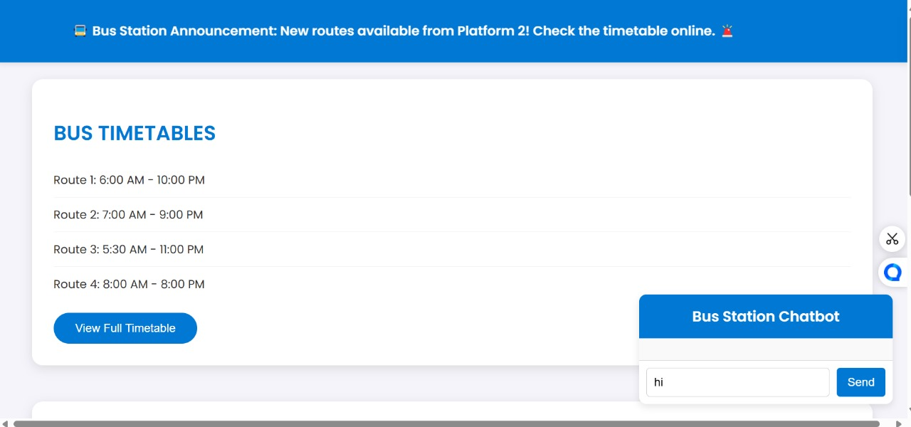
Architecture

Slide 8
Hardware/software components
Software Components:
OPEN AI
Java SCRIPT
HTML
CSS
FLASK

Slide 9
5.OUTCOMES
Increased Efficiency
Enhanced Convenience and Accessibility
Simplified User Experience
Increased Self-Service Capabilities
Faster Problem Resolution
Cost Savings for the Bus Station

Slide 10
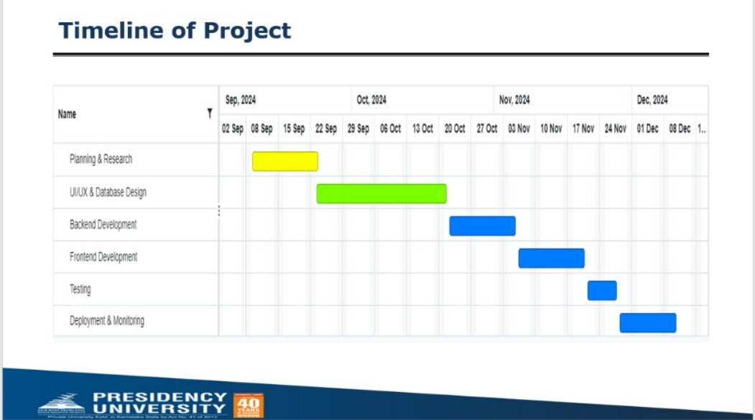
6. TIMELINE OF THE PROJECT/ PROJECT EXECUTION PLAN

Slide 11
7.CONCLUSION
Public announcement and chatbot systems are rapidly transforming the way bus stations operate. These systems are not only used for providing real-time information about schedules, routes, and delays but also offer a wide range of services such as ticket booking, seat reservations, and live bus tracking.

Slide 12
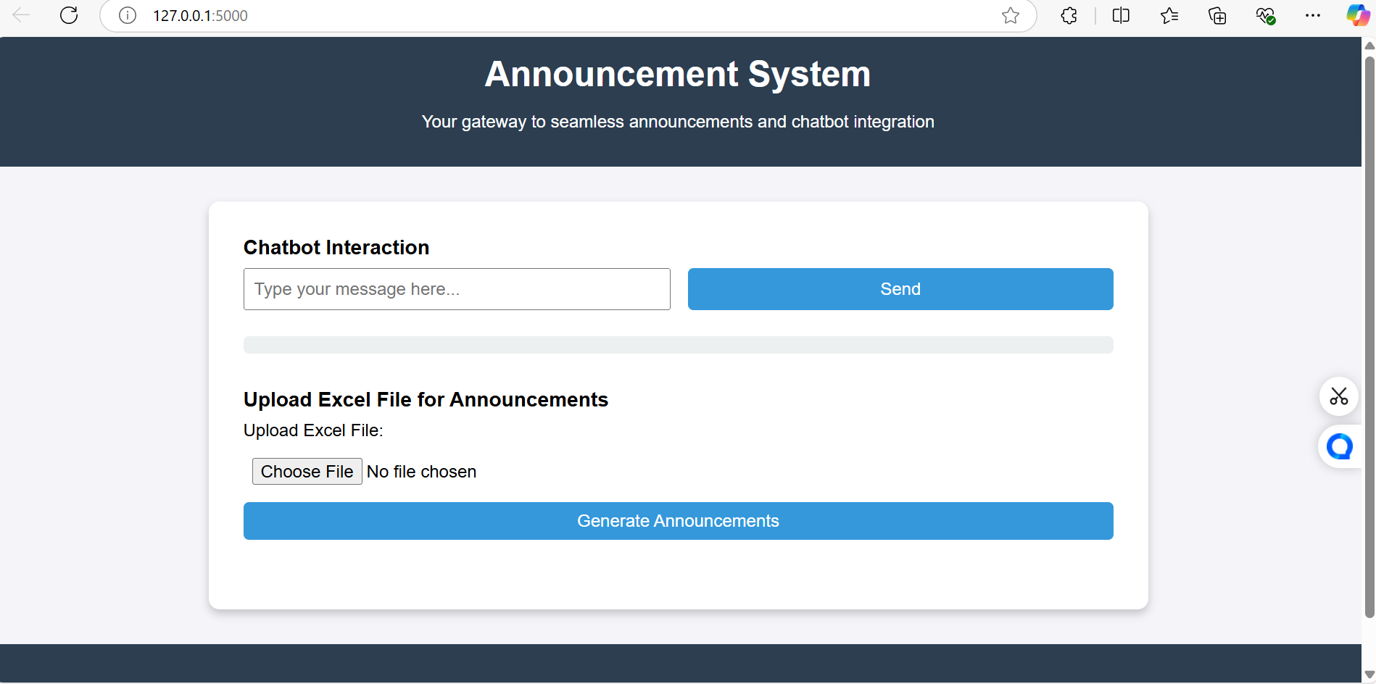
OUTPUT

Slide 13
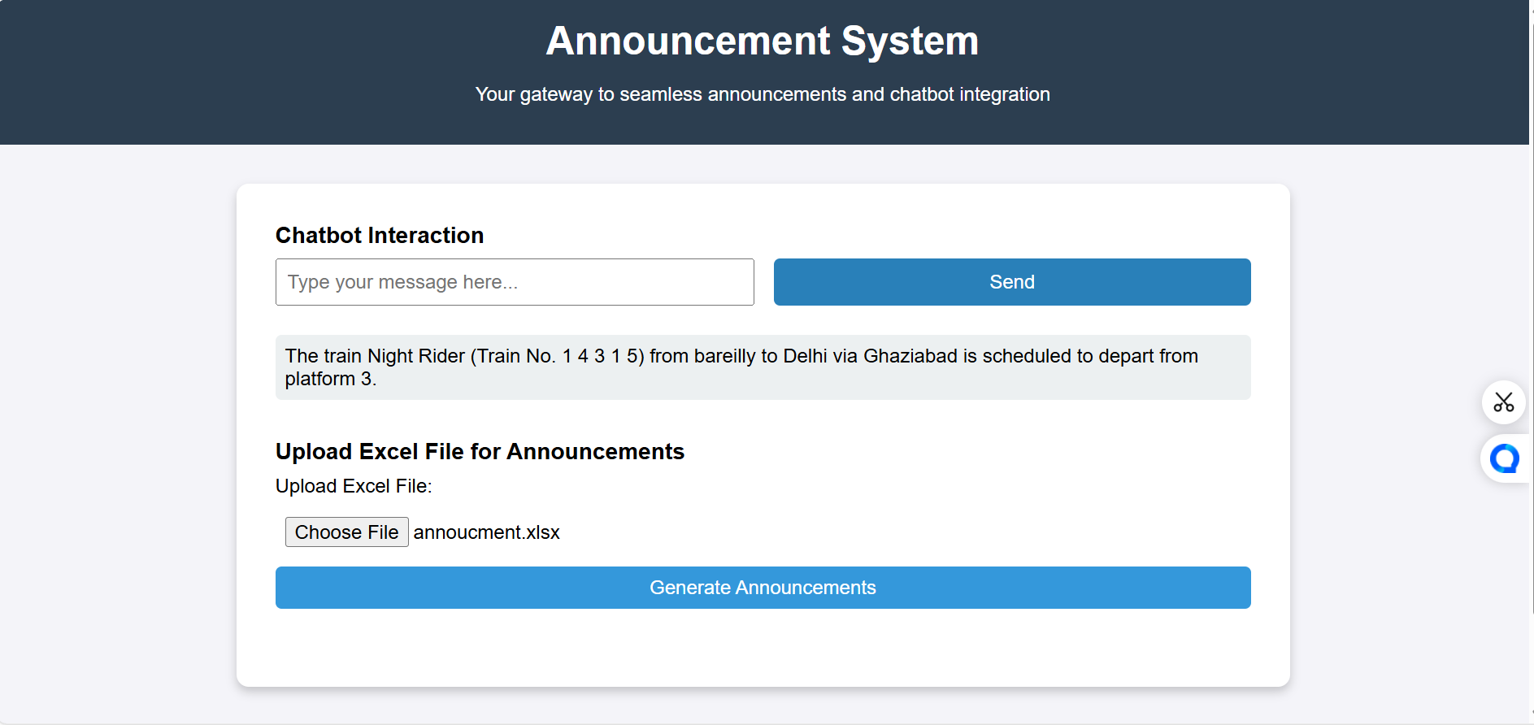
OUTPUT

Slide 14
Thank You

